Slide 1
Public Participation
Key Stage 4

Slide 2



Check your knowledge…
Why does Public participation matter?
How can Public participate?

Slide 3
DEMOCRACY; a government in which the supreme power is vested in the people and exercised by them directly or indirectly through a system of representation usually involving periodically held free elections
DEMOCRACY
meaning comes from 2 words of ancient Greek
‘Demos’
‘Kratos’
Meaning
“The people”
Meaning “rule”
(Merriam-Webster Dictionary)

Slide 4

Why is Public Participation important?
Allows Citizens to have a say in the legislative process
Hold elected representatives accountable
Contribute to the decision-making that affects their lives

Slide 5

Can Public actually participate in work of Majlis?
Article 88 (a)2 of the Maldivian Constitution
“Subject to the provisions of this Constitution, the People’s Majlis shall: make regulations and principles concerning its business, with due regard to representative and participatory democracy, accountability, transparency and public involvement”

Slide 6

What are the ways Public can participate in work of Majlis?

Slide 7




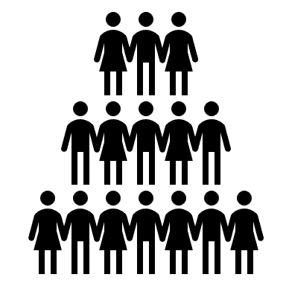
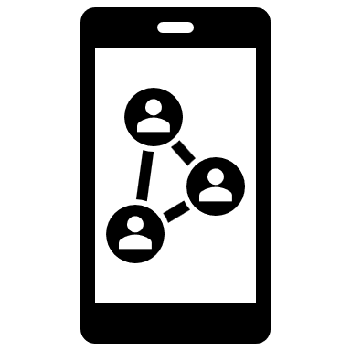
Several ways to get involved…
Voting
Submit letters
Contacting MPs
Attend Parliamentary Sittings and Committee meetings
Petitions
Online Platforms
Notes:
Visiting the Parliament: Citizens can visit the parliament and observe preliminary sittings or committee meetings. The Parliament Office offers guided tours and educational programs for schools and the general public.

Slide 8

Majlis website provides…
MPs official email address and links to social media handles.
Minutes of preliminary sittings and committee meetings
Agenda of preliminary sittings
Bills/motions/resolutions that are under consideration at the Majlis floor (unless confidential)
Committee Reports
Live streamed video of preliminary sittings and live stream of audio is for committee meetings
Public announcements (such as invitation to submit public comments to Bills) are done via all the Majlis social media handles
www.majlis.gov.mv

Slide 9

Group Activity:
Let’s write a Petition!

Slide 10
PETITION;
Noun: a formal written request, typically signed by many people, appealing to authority with respect to a particular cause.
Verb: make or present a formal request to an authority with respect to a particular cause.
What is included in a Petition?
Clear statement of purpose
Supporting facts
Names with signatures

Slide 11
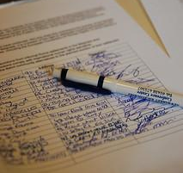
What are the Advantages of a Petition?
Collective Strength
Structured Format
Demonstrates Public Opinion
Ease of Distribution
Engagement and Awareness
Documentation and Record
Peaceful Advocacy
Notes:
Collective Strength: Petitions unite individuals to amplify their voices collectively, showing significant public support or concern.
Structured Format: Petitions have a clear, concise format, enhancing communication by organizing information effectively.
Demonstrates Public Opinion: Petitions visually represent public opinion, with signatures quantifying support or opposition to a cause.
Ease of Distribution: Online platforms make petition creation and sharing easy, enabling widespread participation from diverse locations.
Engagement and Awareness: Petitions call for action, encouraging active participation, raising awareness, and mobilizing individuals.
Documentation and Record: Petitions create a documented record of public concerns or requests, serving as a reference for discussions.
Peaceful Advocacy: Petitions offer a peaceful, organized way for individuals to express views, especially when protests may not be suitable.

Slide 12

Lets write a Petition!
Step 1 – Decide to whom you want to submit the petition to. In your greeting, use their name to start your letter politely.
Step 2 – Start the body of the letter with a statement to explain your issue. Add supporting facts to convince why this is important. State what you want to change. End with the course of action you would like to suggest as a solution to this issue.
Step 3 – Add signatures of people who agree and support your issue to the bottom of your letter.

Slide 13

Questions?

